Slide 1
IMAGE DEHAZING
BATCH A_GROUP 6
21AIE303 SIGNAL & IMAGE PROCESSING

Slide 2
Members:
MARREDDY MOHIT SASANK REDDY CB.EN.U4AIE21031
YARRAM SRI SATHWIK REDDY CB.EN.U4AIE21077
B.HARISH BALAJI CB.EN.U4AIE21007
PENTYALA SAI VIJAY KUMAR CB.EN.U4AIE21040

Slide 3
Content
Introduction
DCP using Morphology
CAP using HLP
CLAHE
Metric Analysis

Slide 4
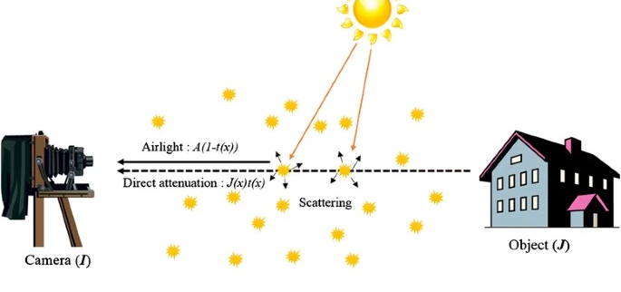
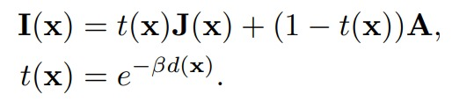
Introduction
The observed hazy image, I(x) ∈R N×3, is a convex linear combination of the haze-free scene radiance, J(x), and the atmospheric light component, A, called the air light; usually represented as a constant 3-vector in RGB space, A =(A^{r}, A^{g}, A^{b}).
The transmission map coefficients, t(x) ∈ R^{N} control the relative force of each component, in each pixel in the image, x ∈ R^{N} .
The transmission is a function of the depth, d(x), of the scene from the observer.

Slide 5
Dark channel prior using morphology:
Dark Channel Prior:
• This algorithm has three main objectives:
• Estimate atmospheric light
• Find Transmission map
• Smoothen Transmission map using regularization
Atmospheric light and the transmission map are computed using concepts similar to Dark Channel Prior. But to refine the transmission map, we used the concepts of morphology.

Slide 6
The basic idea behind the dark channel prior is that, in most natural images, there is a small patch of pixels that have very low intensity values in at least one color channel.
This patch of pixels is called the dark channel, and it is used to estimate the atmospheric transmission map
I(x) = t(x)J(x) + (1 − t(x))A
This is the equation represents the image captured where I(x) is Image captured J(x) is the actual scene radiance without haze A is atmospheric light and t(x) is transmission.

Slide 7
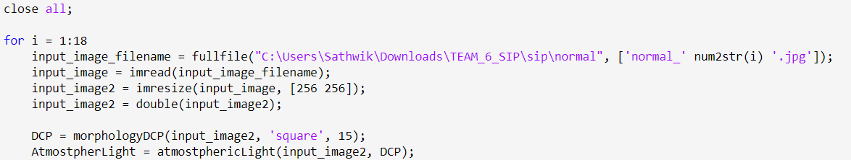
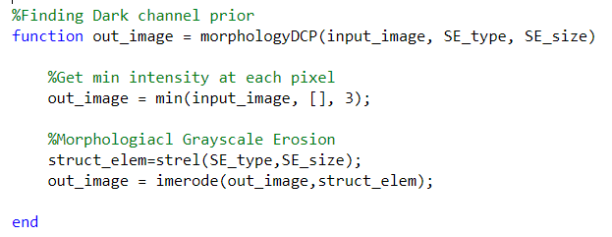
1)Computation of the Dark Channel Prior
2) Morphological Grayscale Erosion

Slide 8
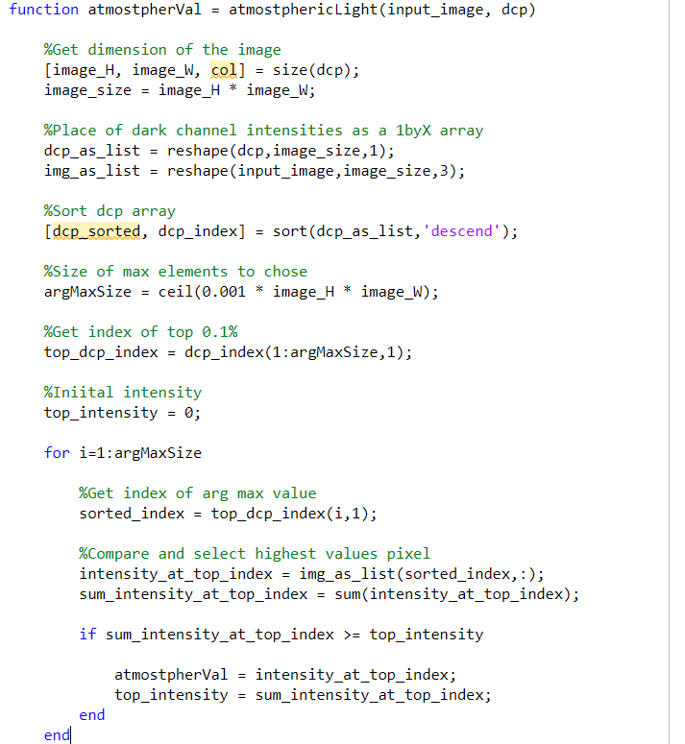
Sorting Dark Channel Intensities
Selection of Top Pixels
Iteration Over Top Pixels
Estimation of Atmospheric Light

Slide 9
Steps for finding transmission map:
normalize the input image based on the estimated atmospheric light.
compute the minimum channel by finding the minimum intensity at each pixel across color channels.
create the initial transmission map by subtracting the minimum channel values from 1.
perform morphological closing by reconstruction on the initial transmission map.
perform morphological opening by reconstruction on the closing reconstructed transmission map.
calculate the difference between two transmission maps, identifying regions where small objects are clearer than the environment.
recover the ranges of values from the original transmission maps.
r_value = (t1_max - t1_min) / (t3_max - t3_min)
first_Bracket = transMap3 - t3_min
out_image = (first_Bracket * r_value) + t1_min
refine the transmission map by summing it with an image where small objects have been removed.

Slide 10
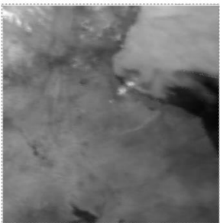
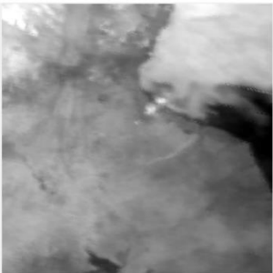
Intial transmission map
Refined transmission map

Slide 11
Code:
Functions:
DCP = morphologyDCP(input_image2, 'square', 15);
AtmostpherLight = atmostphericLight(input_image2, DCP);
normalizedInput = normalizeImage(input_image2, AtmostpherLight);
minimalChannel = minimumChannel(normalizedInput);
t1 = initialTransMap(minimalChannel);
t2 = closingRecontruction(t1, 'square', 15);
t3 = openingRecontruction(t2, 'square', 15);
R = removedSmallObjects(t1, t3);
t3_prime = recoverRanges(t1, t3);
t_morf = refineTransmissionMap(t3_prime, R);
dehazed_img = removeHaze(input_image2, t_morf, AtmostpherLight);

Slide 12
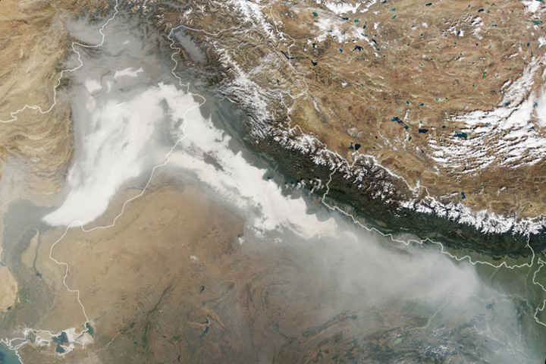
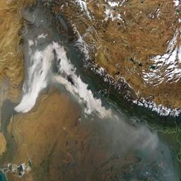
Input - 1
Image with haze:
Dehazed image:

Slide 13
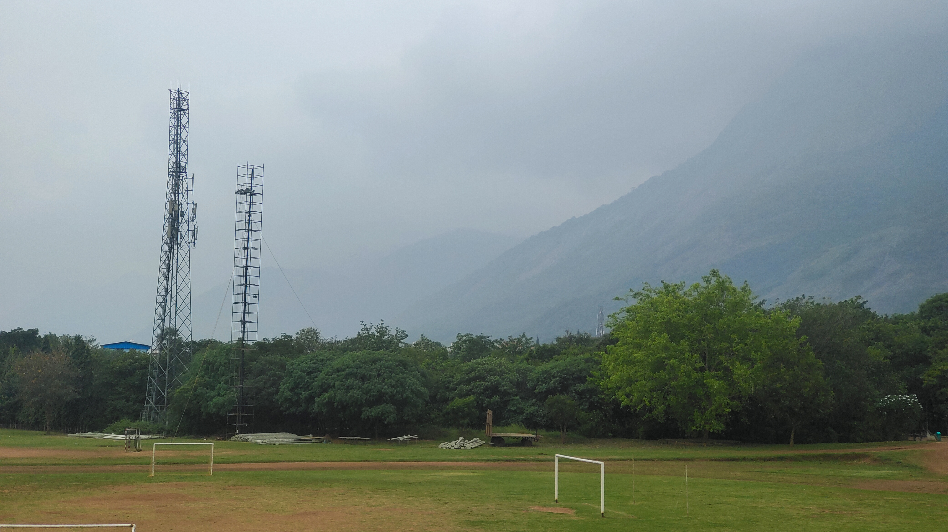
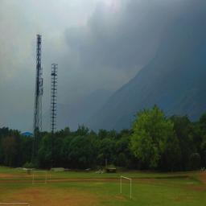
Input - 2
Image with haze:
Dehazed Image:

Slide 14
Color attenuation prior using Haze lines prior:
The color attenuation prior assumes that in a hazy image, the scene's colors are attenuated (scaled down) uniformly along the transmission path. The haze line prior is a simplified model that describes the relationship between the observed color of a pixel in a hazy image and its corresponding true color in the haze-free scene.
This algorithm is mixture of CAP and Haze line prior algorithms. The main objective of this algorithm:
• Find the scene depth
• Find the scattering coefficient
• Estimate the airLight

Slide 15
How to find scene depth:
In order to find the scene depth we use CAP algorithm. This algorithm states that:
‘If the thickness of the haze increases the scene depth also increases’.
Hence the scene depth of the image will be linearly dependent on the difference between brightness and saturation in the image. Using this we estimate the scene depth.
How to find scattering coefficient:
In general scattering coefficient is kept constant as in most of the images the haze is evenly spread. But in case of satellite images the haze is inconsistent and unevenly spread. So the scattering coefficient must keep changing.
Scattering coefficient directly depends on scene depth. Hence with an increase in scene depth, scattering coefficient increases exponentially.

Slide 16
How to find airlight:
In order to estimate the airLight we use Haze lines Prior.
In this algorithm, we map the pixels in the image to RGB colorspace. Then the model takes these pixels as lines and these lines converge at a point.
And this point is airlight
we use a feature extraction model in order to find the origin point for this airLight.
After finding scene depth, scattering coefficient and estimating the airlight, we send these values to our model in order to get the dehazed image.

Slide 17
Depth Finding
If the value of r is not provided as an input argument, it is set to the default value of 15.
The input RGB image I is converted to the HSV color space using the rgb2hsv function.
The saturation (s) and value (v) channels of the HSV image are extracted.
A Gaussian noise matrix sigmaMat is generated with a standard deviation of 0.041337 and added to the size of the image.
An output map is calculated using a combination of the value channel (v), saturation channel (s), and the Gaussian noise (sigmaMat).
The output map is then filtered using an order-statistic filter (ordfilt2) with a square neighborhood of size r. This filter appears to be applied in a symmetric mode.
The original and filtered maps (outputPixel and outputRegion, respectively) are returned as outputs.

Slide 18
Atmospheric light
If the third input argument isShowImg is not provided, it is set to 1 by default, indicating that the function will display an image for visualization purposes.
The input image img is converted to double precision if it is initially an integer image.
The number of pixels corresponding to 0.1% of the brightest pixels in the dark channel prior (Jdark) is computed.
The dark channel values are sorted, and the corresponding locations are stored in Loc.
The image is column-stacked into a 2D matrix (Ics), and the dark channel values are also stored in a column vector (dx).
A matrix (Acand) is initialized to store candidate airlight pixels, and another matrix (Amag) is initialized to store the magnitudes of RGB vectors of airlight candidates.
For each of the brightest pixels in the dark channel, the corresponding pixel in the original image (ix) is set to a red color (1,0,0), and the RGB values of the candidate airlight pixel are stored in Acand.
The magnitudes of RGB vectors of the candidate airlights are computed and stored in Amag.

Slide 19
The candidate airlights are sorted based on their magnitudes.
The best estimate of the atmospheric light (A) is obtained by selecting the candidate airlights corresponding to the 20 brightest pixels in the dark channel prior.
If there are fewer than 20 pixels, the function uses all available candidate airlights.
If there is more than one candidate airlight, the function selects the maximum value for each channel.
If isShowImg is set to 1, the function displays an image highlighting the position of the estimated atmospheric light.

Slide 20
Dehazing code
Input Image.
Saliency Map Calculation
Call the calVSMap function to calculate the visual saliency maps (dR and dP) for the input image.
r is set to 15.
Guided Image Filtering
Apply guided image filtering to refine the saliency maps.
imguidedfilter is used with parameters for the neighborhood size (gimfiltR) and degree of smoothing (eps).
Transmission Map Calculation
Calculate transmission maps (tR and tP) based on the refined saliency maps.

Slide 21
Atmospheric Light Estimation
Estimate the atmospheric light using the estA function based on the dark channel prior.
Image Dehazing
Dehaze the input image using the estimated atmospheric light and transmission maps.
Display and Save Results
Display and save the dehazed image, as well as additional visualizations.

Slide 22
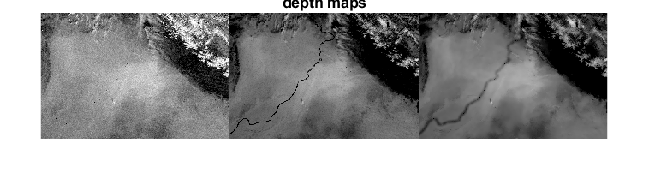
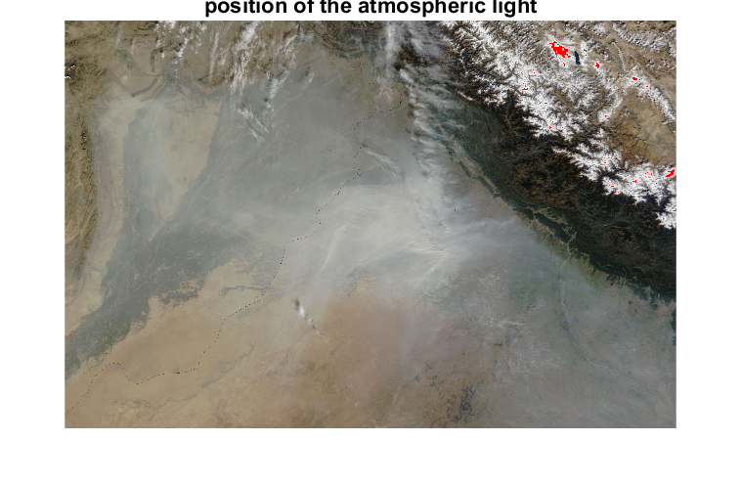
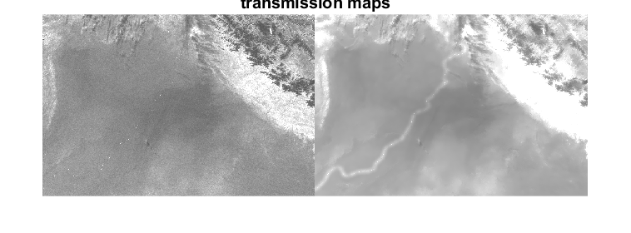
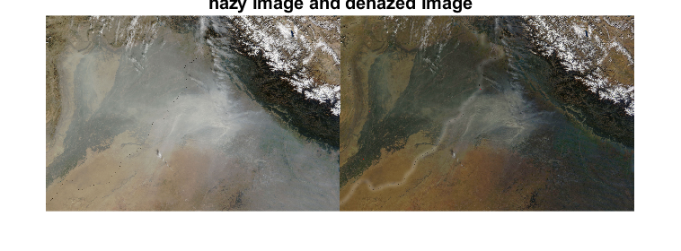
Input and output for CAP using HLP
Input - 1

Slide 23
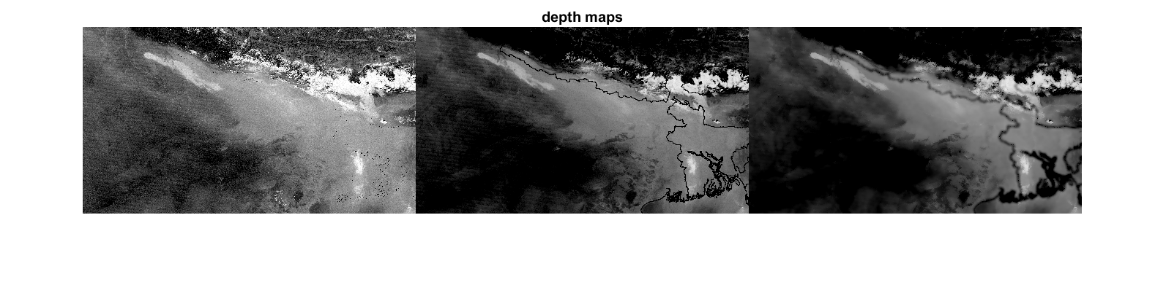
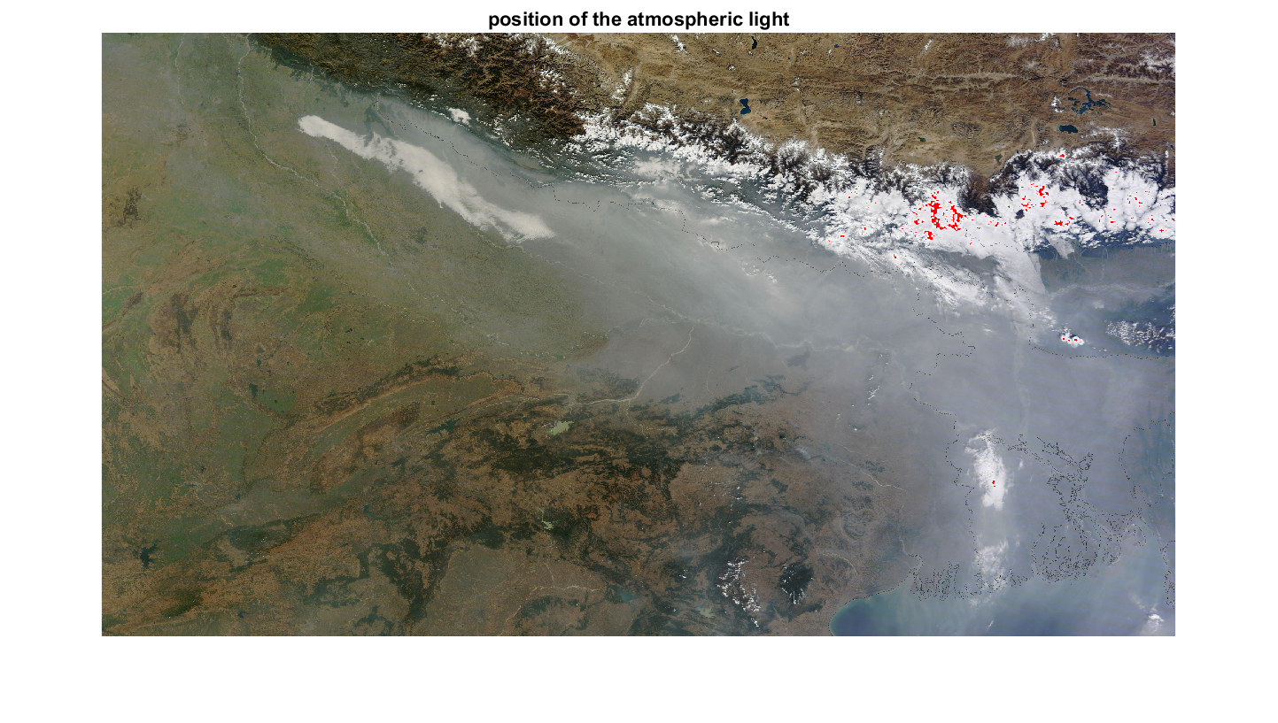
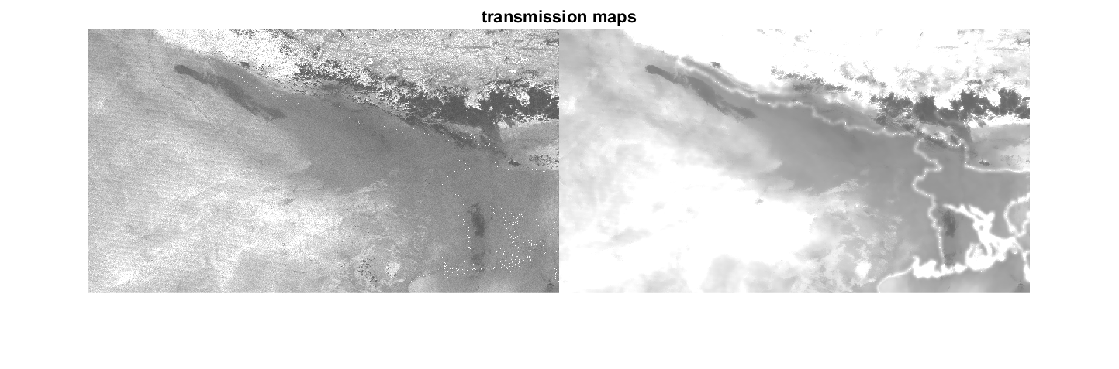
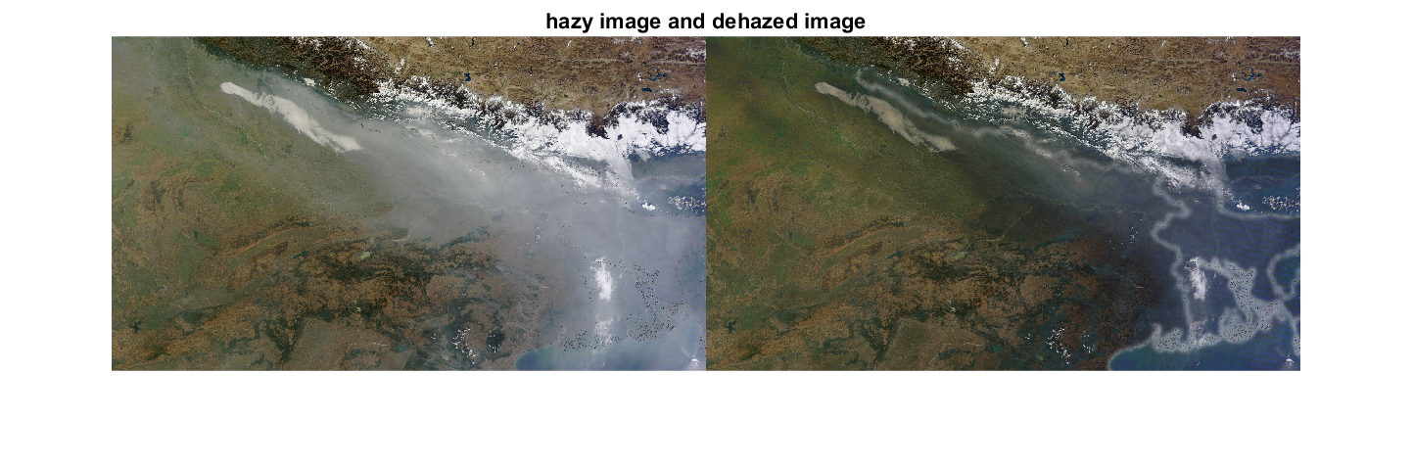
Input - 2

Slide 24
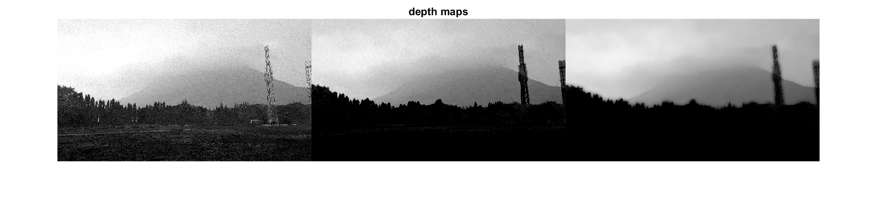
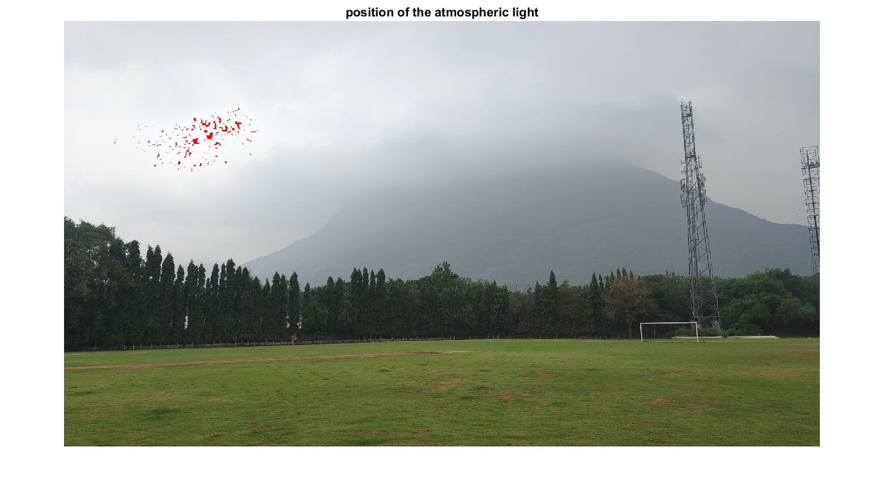
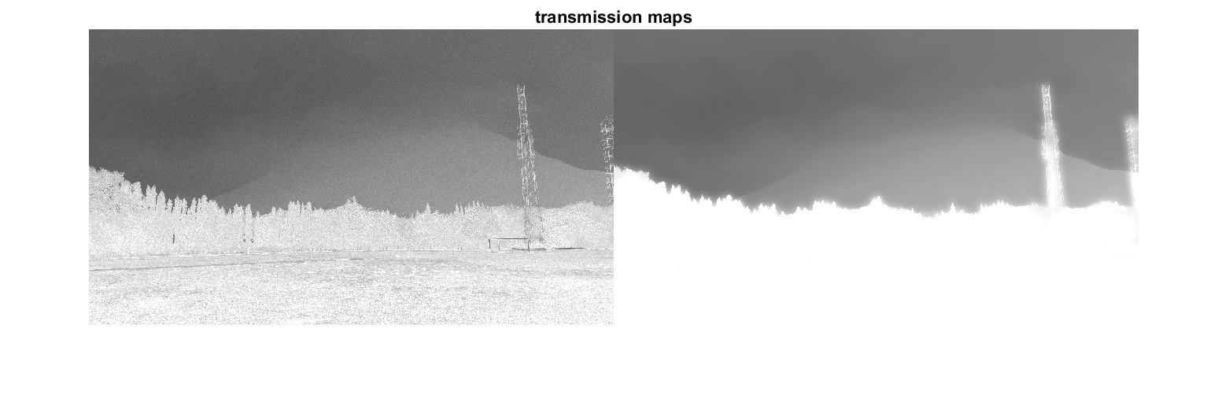
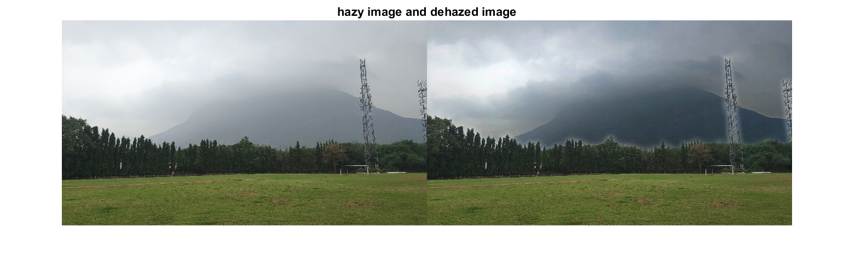
Input - 3

Slide 25
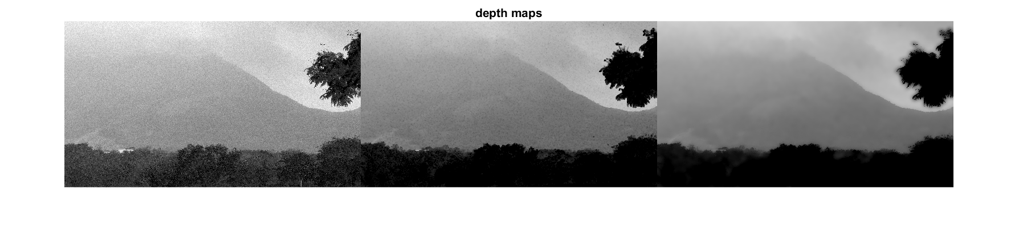
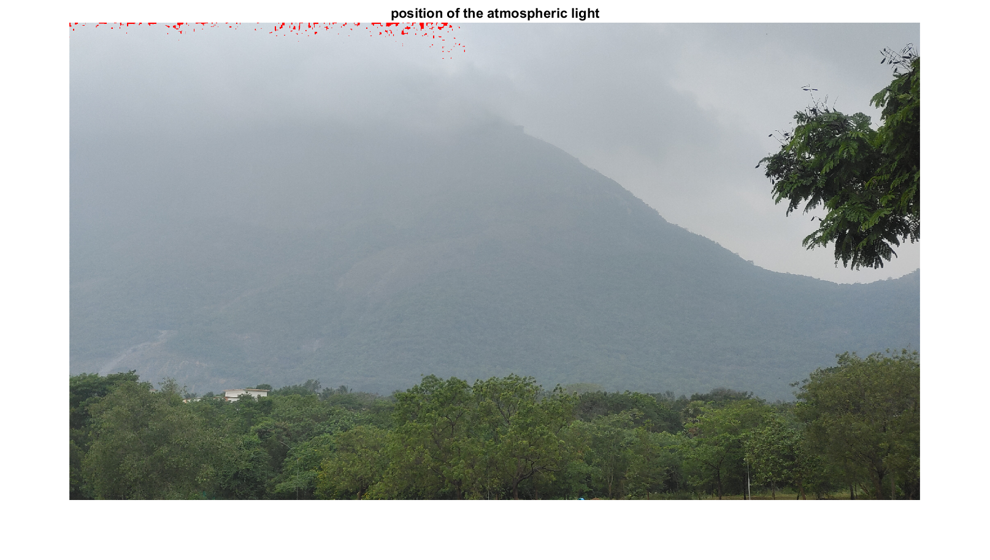
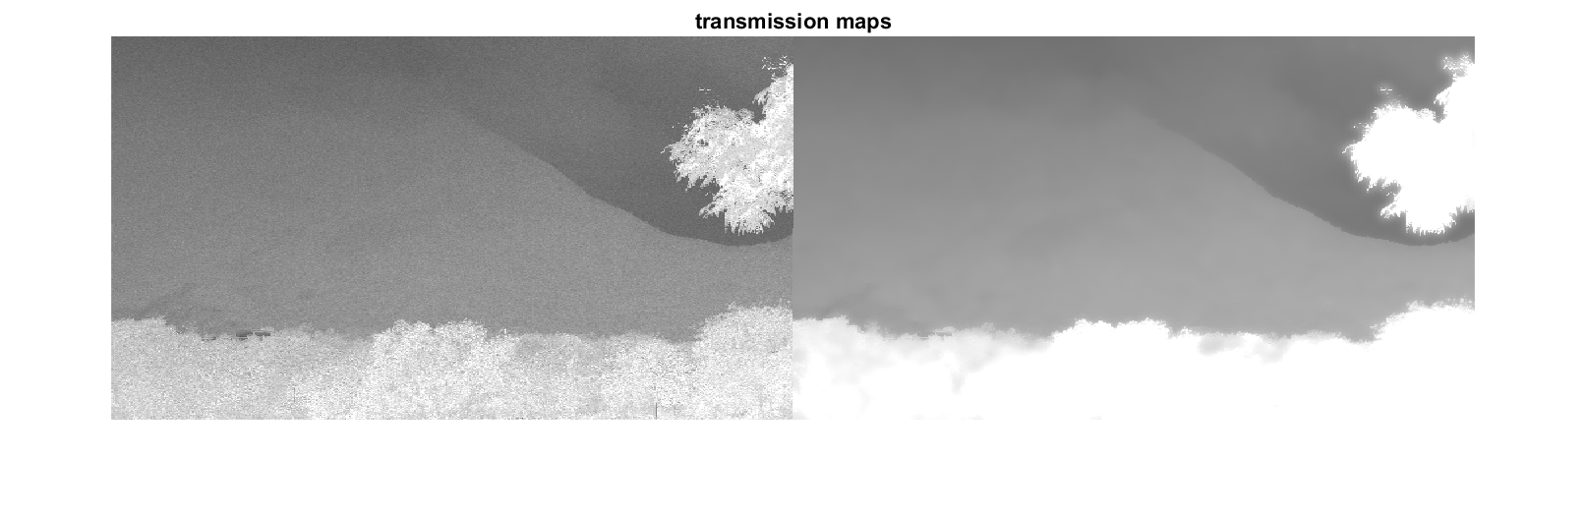
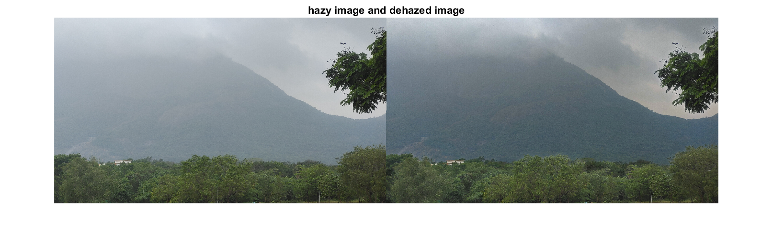
Input - 4

Slide 26
Limitations of CAP using HLP
Assumption of Homogeneous Haze.
Sensitivity to Scene Complexity.
Limited Effectiveness in Extreme Haze Conditions.
Impact on Computational Resources
Difficulty in Handling Non-uniform Illumination

Slide 27
CLAHE:
ENTER TEXT HERE:
This algorithm defines two functions, clahe and clahe2, which can be used to apply the Contrast Limited Adaptive Histogram Equalization (CLAHE) algorithm to an image.
The clahe function takes three parameters:
image: The input image, which should be a 2D array.
clipping_limit: A float value that sets the limit for contrast enhancement. Higher values allow for more contrast enhancement, but can also amplify noise in the image. The default value is 5.0.
grid_size: A tuple that sets the size of the contextual regions, which are the small regions of the image that the algorithm adjusts the contrast of separately.

Slide 28
Process :
The function first gets the dimensions of the input image, and then divides the image into nonoverlapping contextual regions based on the grid_size parameter.
It then creates an output image (clahe_image) that is the same size as the input image, but filled with zeros.
The function then performs CLAHE on each grid. For each grid, it:
• Gets the grid region of the image by slicing the input image with the grid's row and column indices.
• Gets the histogram of the grid region, which is a distribution of the number of pixels of each intensity level in the grid region.

Slide 29
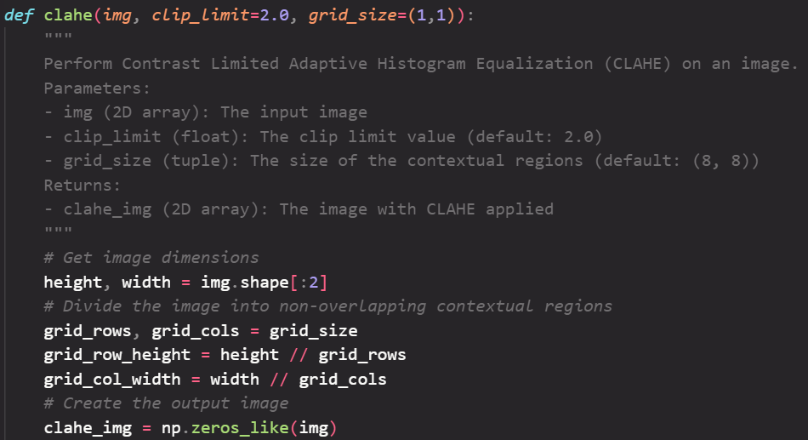
Code :

Slide 30
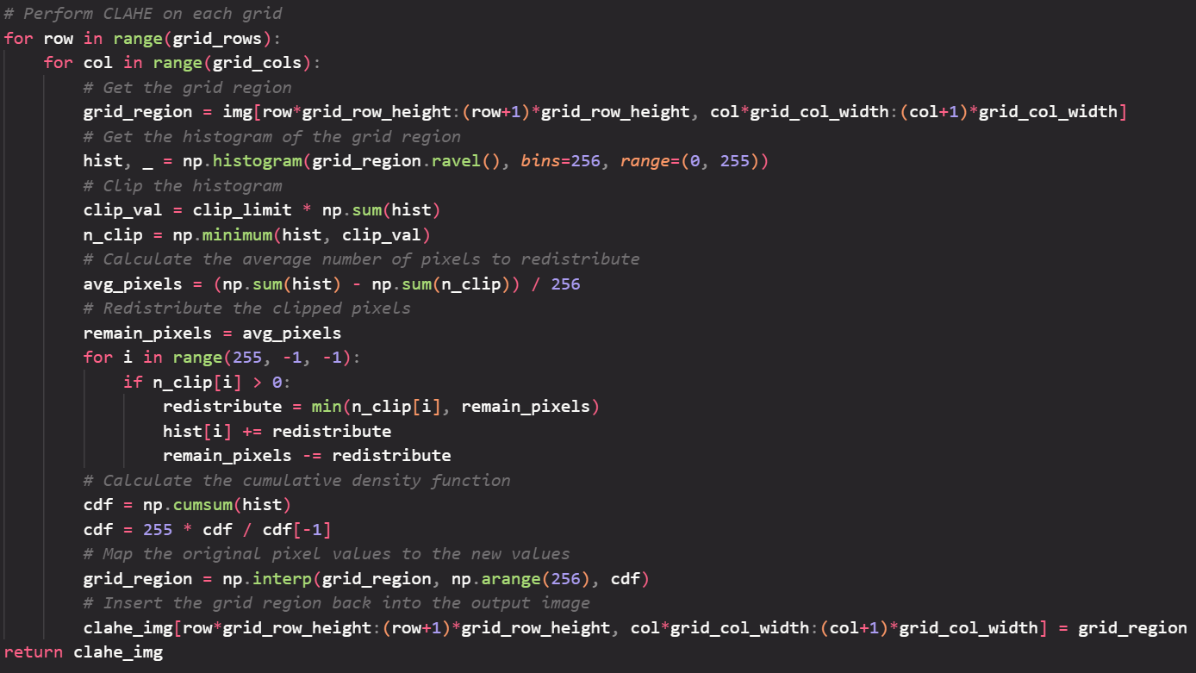
Code method :

Slide 31
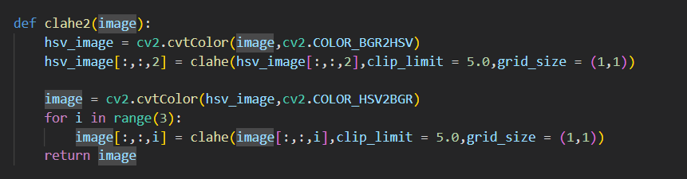
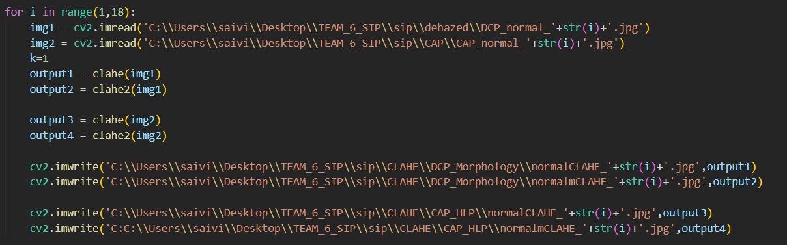
Clahe2 method :
Image location :

Slide 32
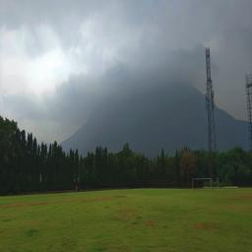
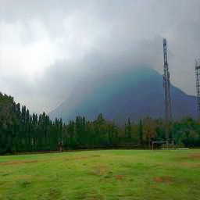
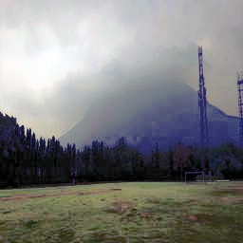
DCP_normal
Dcp_morphology image
Input image
clahe
clahe2

Slide 33
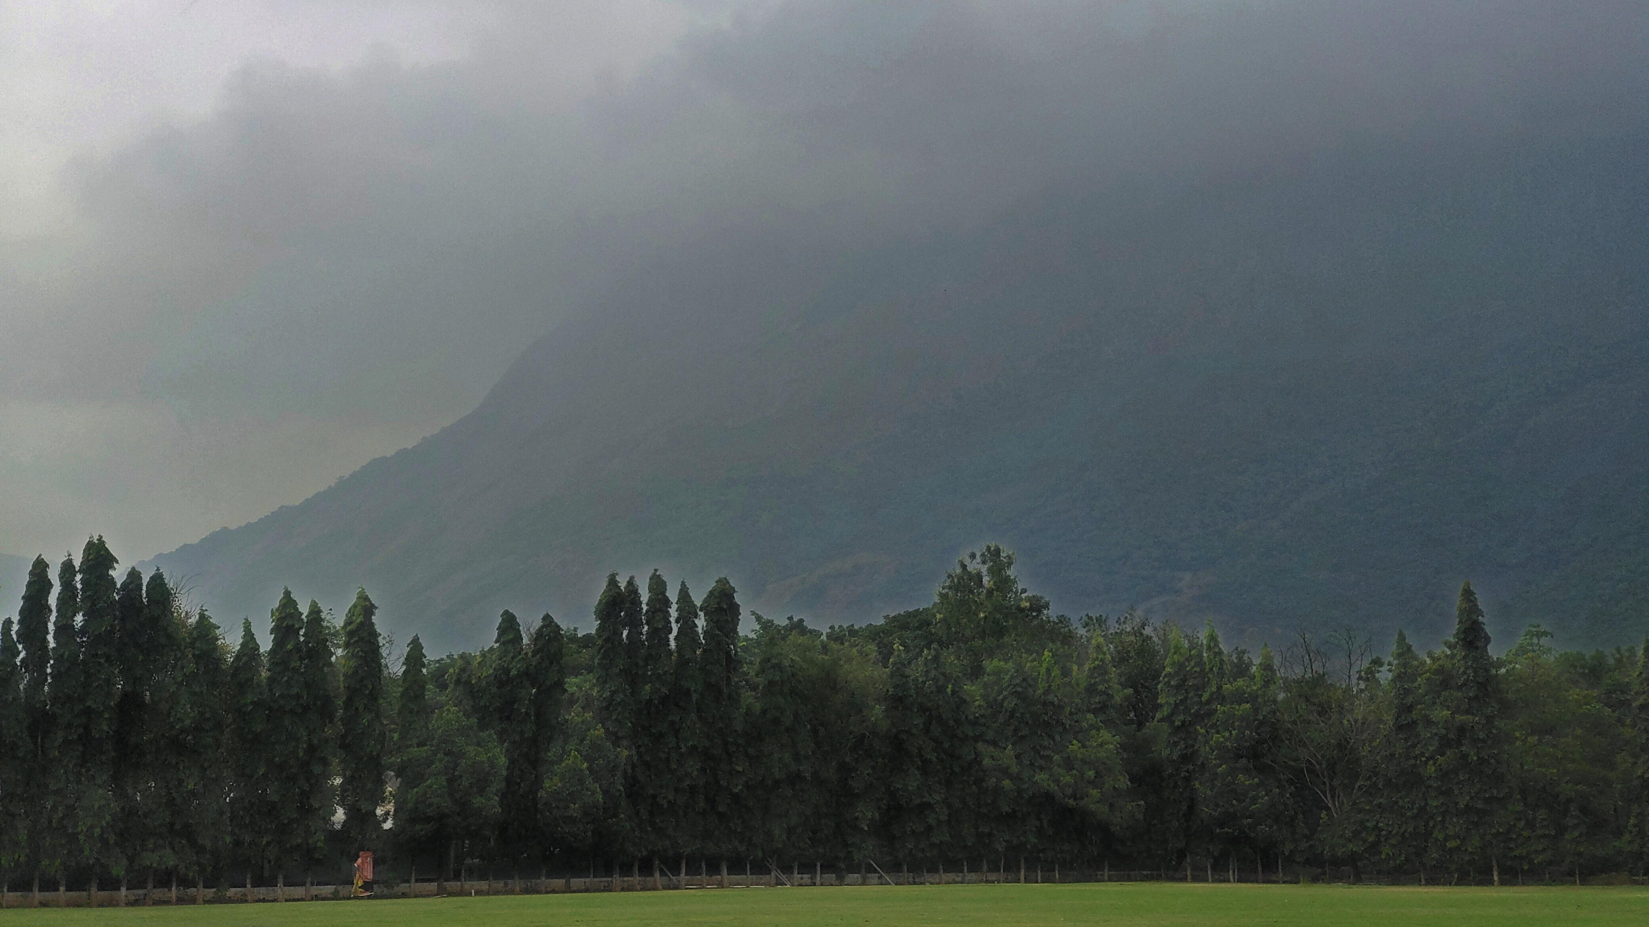
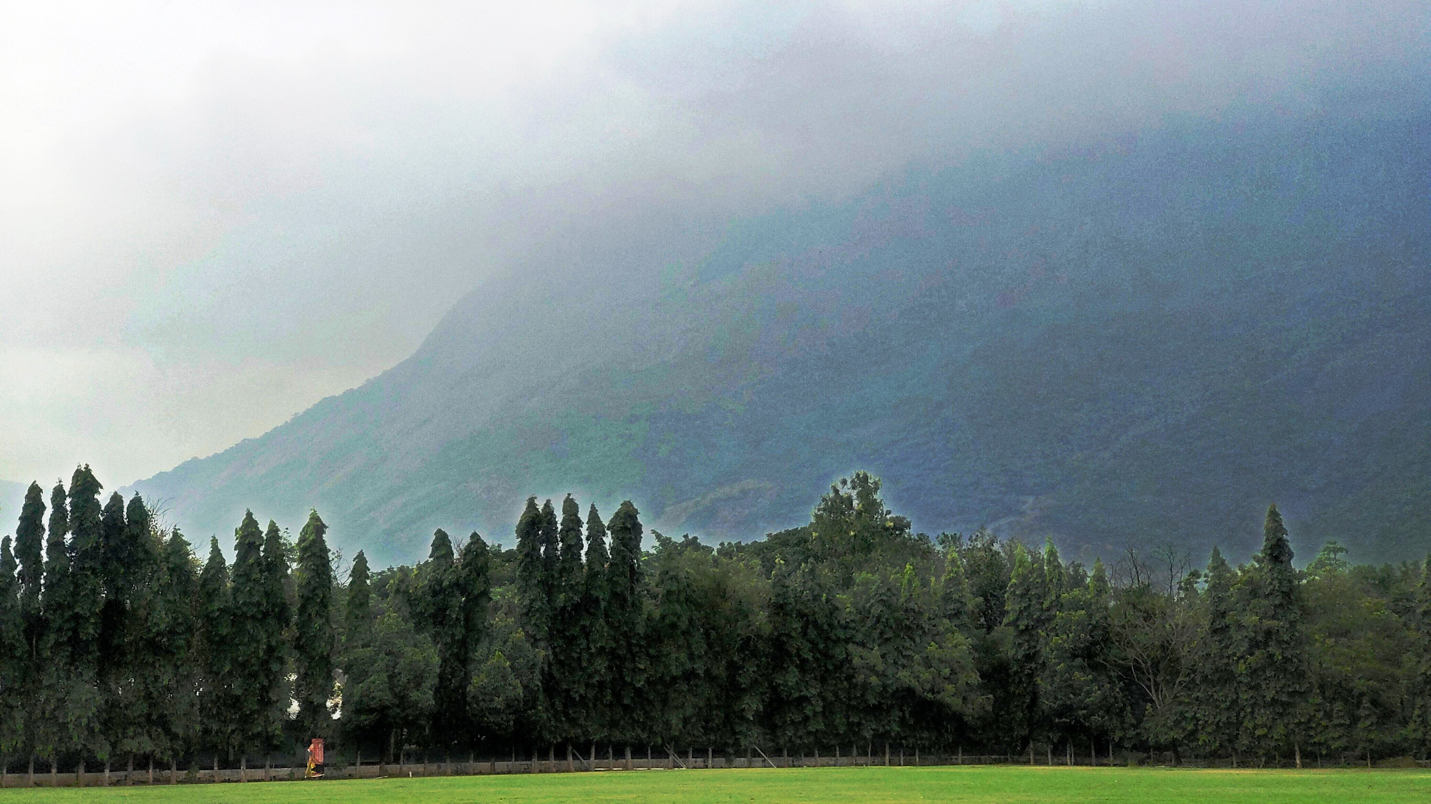
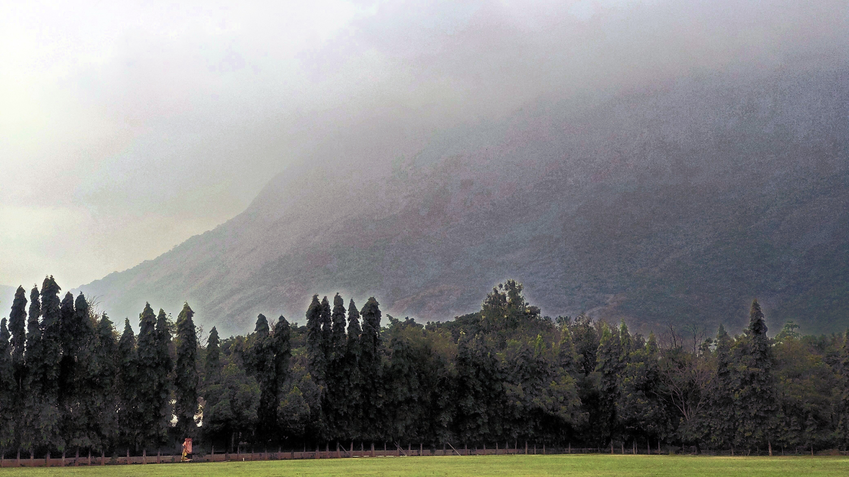
CAP normal
Cap normal image
Input image
clahe
clahe2

Slide 34
Metric analysis:
For metric analysis of our code, we took 2 mothods:
PSNR (Peak Signal-to-Noise Ratio)
SSIM (Structural Similarity Index)
Peak Signal-to-Noise Ratio (PSNR) and Structural Similarity Index (SSIM) are metrics commonly used to evaluate the quality of images. Both metrics provide quantitative measures to assess how well a processed or compressed image compares to the original, with higher values indicating better quality.

Slide 35
Peak Signal-to-Noise Ratio (PSNR):
Definition: PSNR measures the ratio of the maximum possible power of a signal (like an image) to the power of the signal's noise. It's expressed in decibels (dB).
Interpretation: A higher PSNR value indicates a smaller amount of noise and better image quality. It is commonly used to assess the fidelity of image compression or denoising algorithms.
Structural Similarity Index (SSIM):
Definition: SSIM is a metric that evaluates the structural information in images. It takes into account luminance, contrast, and structure, aiming to capture changes in structural information that are perceptually important.
Interpretation: SSIM values range from -1 to 1, with 1 indicating identical images. Higher SSIM values imply better similarity between the images being compared.
PSNR focuses on the difference in pixel values, whereas SSIM incorporates more perceptual aspects of human vision.

Slide 36
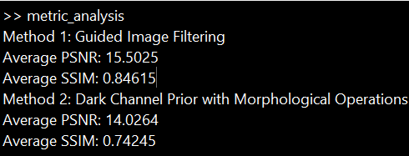
Output of metric analysis
Here we can see that Guided Image Filtering(CAP) has better results than DCP using Morphology

Slide 37
CONTRIBUTION:
MARREDDY MOHIT SASANK REDDY | Dcp using morphology
YARRAM SRI SATHWIK REDDY | Dcp using morphology
B.HARISH BALAJI | CAP using Haze line prior
PENTYALA SAI VIJAY KUMAR | CLAHE

Slide 38
Thank you

